Slide 1
Chapter 7: Software is Everywhere
IOT CƠ BẢN
502068

Slide 2
Ghi chú về bản quyền
Toàn bộ nội dung bài giảng là của CISCO, sinh viên có quyền tải về, lưu trữ, in ấn, tham khảo cho mục đích học tập. Sinh viên không được phát hành lại hay thay đổi nội dung slide nếu chưa có sự đồng ý của chủ sở hữu.
Phần ghi chú ở cuối slide (nếu có) là do các thầy cô ghi chú lại trong quá trình giảng dạy.

Slide 3
Chapter 3: Software is Everywhere
Connecting Things
Notes:
Cisco Networking Academy Program
Connecting Things
Chapter 3: Software is Everywhere

Slide 4
Chapter 3 - Sections & Objectives
3.1 Programming
Explain the value of computer programs.
3.2 The Raspberry Pi Single Board Computer (SBC)
Use the Raspberry Pi for simple applications.
3.3 Building Models of IoT Systems in Packet Tracer
Use Packet Tracer to model IoT systems.
Notes:
3

Slide 5
3.1 Programming
Notes:
Cisco Networking Academy Program
Connecting Things
Chapter 3: Software is Everywhere

Slide 6
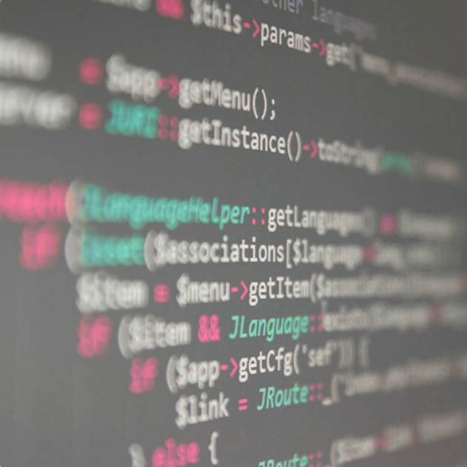
Programming 3.1.1 What is Code?
What is a Program
Code is a set of ordered instructions created to accomplish a specific task.
A bread recipe can be seen as a program.
Computer programs can be written in different programming languages.
Programs are Everywhere
All computers need programs.
Operating Systems, firmware, and applications are
examples of programs.
Why Learn Code?
Programmers are valued in the job market.
Today, programmers may work on firmware, device
drivers, mobile applications, web interfaces, data
analysis, and more.
Programmers can create their own tools.
Notes:
3.1 – Programming
3.1.1 – What is Code?

Slide 7
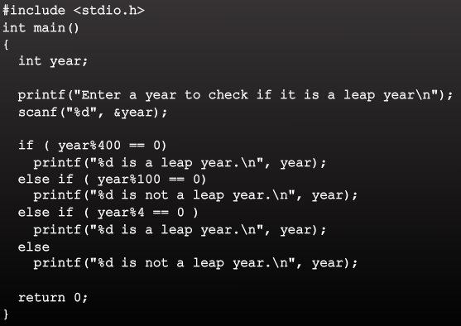
Programming 3.1.2 Code Does the Job!
What Makes Up a Program?
Programs allow people impart logic to computers and are made out of logic structures.
IF-THEN, FOR Loops, and WHILE Loops are a few logical structures commonly found in programs.
Interpreted Vs. Compiled
Interpreted languages rely on another program to read, parse, and execute the code.
Compiled languages rely on a compiler, another program, to turn the human-readable code into a binary executable code.
Computer Languages
There are several different computer languages.
Some computer languages are better than others at certain types of tasks.
JavaScript, Python, Blockly, C, and Java are examples of computer languages.
Notes:
3.1 – Programming
3.1.2 – Code Does the Job!

Slide 8
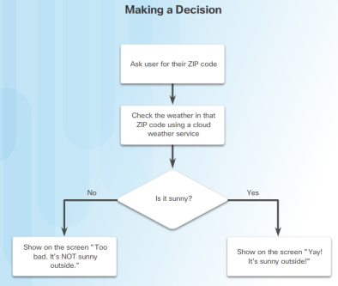
Programming 3.1.3 Lending Intelligence
IOT Devices and Data Processing
A common IoT application uses sensors to collect data.
Data is often not useful until it has been processed. Collected data is often transported and stored in the cloud for processing at a later date.
IoT Devices Make Decisions
Software must be written and uploaded onto IoT devices to allow them to make decisions.
Decisions can be as simple as triggering an alarm or as complex as facial recognition.
Software APIs
Application Program Interface (API) is a set of routines and software tools that facilitate one application communicating with another.
Different types of APIs exist: operating system APIs, application APIs, website APIs.
APIs allow applications to communicate, share data, or ask for specific services from another application.
Notes:
3.1 – Programming
3.1.2 – Code Does the Job!

Slide 9
Programming Lending Intelligence – cont’d
REST API
REST APIs use HTTP based calls between applications to access and manipulate information stored on powerful databases.
Web resources used to be identified using a URL. Now resources can be any entity or thing that can be addressed: today’s step goal, house temperature setting, glucose setting.
A unique Uniform Resource Identifier (URI) can identify an entity. A URI typically begins with a slash (/steps)
REST API requests trigger responses in well-defined formats such as XML or JSON
Notes:
3.1 – Programming
3.1.2 – Code Does the Job!

Slide 10
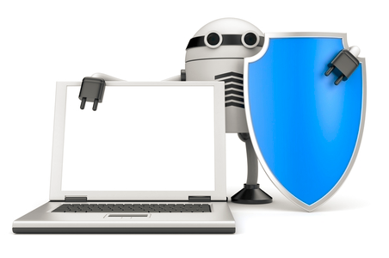
Programming Lending Intelligence – cont’d
Securing the Code
Devices should protect themselves from attacks that impair its function or allow it to be used for unintended purposes without authorization.
Devices should protect the private authentication credentials and key material from disclosure to unauthorized parties.
Devices should protect the information received, transmitted, or stored locally on the device, from inappropriate disclosure to unauthorized parties.
Devices should protect themselves from being used as a vector to attack other devices or hosts on the Internet.
Notes:
3.1 – Programming
3.1.2 – Code Does the Job!

Slide 11
3.2 The Raspberry Pi Single Board Computer (SBC)
Notes:
Cisco Networking Academy Program
Connecting Things
Chapter 3: Software is Everywhere

Slide 12
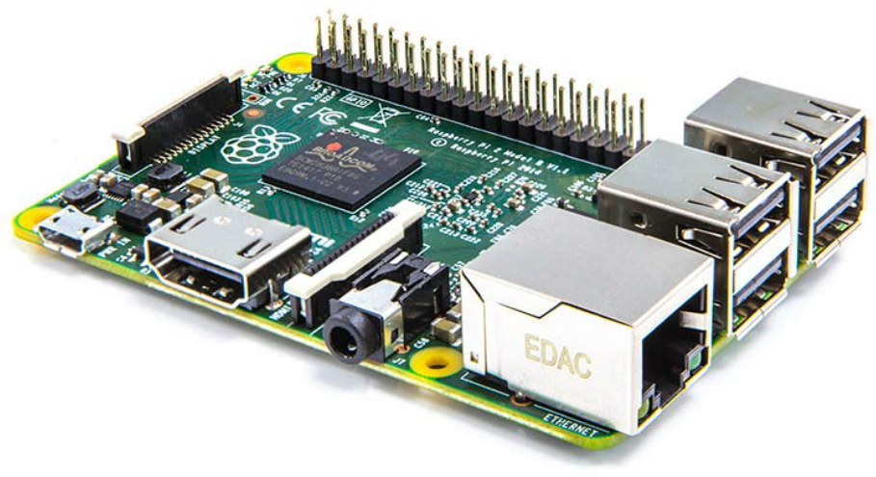
The Raspberry Pi Single Board Computer (SBC) 3.2.1 Raspberry Pi Hardware
The Raspberry Pi and its Ports
The Pi is a small and inexpensive computer.
It has a number of USB ports that can be used to connect various devices including keyboards, mice, external drives and cameras.
The Pi includes an 10/100Mbps Ethernet port and 40 GPIO pins, operating at 3.3V.
Other Pi ports include an audio out, a micro SD card slot, and a micro USB (used for power) connector.
The Pi3 also adds:
1.2 Ghz 64-bit quad-core ARMv8 CPU
802.11n Wireless LAN
Bluetooth 4.1
Bluetooth Low Energy (BLF)
The Pi can run a number of operating systems, including Linux and Windows.
Notes:
3.2 – The Raspberry Pi Single Board Computer (SBC)
3.2.1 – Raspberry Pi Hardware

Slide 13
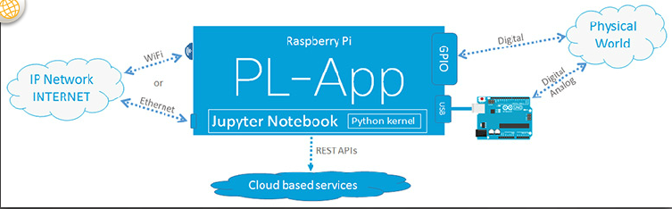
The Raspberry Pi Single Board Computer (SBC) 3.2.2 PL-App
The Raspberry Pi can be accessed locally:
1. Install an operating system image on the micro SD card.
2. Place the card in the micro SD card slot of the RaPi.
3. Connect a USB keyboard.
4. Connect a monitor or TV using the HDMI port.
5. Power the device with a power adapter.
The Raspberry Pi can be accessed remotely using the PL-App
Notes:
3.2 – The Raspberry Pi Single Board Computer (SBC)
3.2.1 – Raspberry Pi Hardware

Slide 14

The Raspberry Pi Single Board Computer (SBC) 3.2.3 Using the Linux Operating System
Understanding Linux
Linux is open source, fast, reliable and small and requires very little hardware resources to run.
Linux is part of several platforms; from wristwatches to supercomputers.
Linux distributions include the Linux kernel, plus a number of customized tools and software packages.
Debian, Red Hat, Ubuntu and Slackware are just a few examples of Linux distributions.
Raspbian is a Linux distribution based on Debian and created specifically for the Raspberry Pi.
Accessing the Linux Shell
The Linux operating system can be divided into kernel and shell.
The shell is a command interpreter.
The shell is text based and also called CLI (command line interface
Notes:
3.2 – The Raspberry Pi Single Board Computer (SBC)
3.2.3 –Using the Linux Operating System

Slide 15
The Raspberry Pi Single Board Computer (SBC) Using the Linux Operating System (Cont.)
Accessing the CLI
The CLI can be accessed directly through a shell in non-graphical systems.
Bourne Shell (sh), Bash (bash), C Shell (csh), improved C Shell (tcsh), and Z Shell (zsh) are popular shells.
A terminal emulator application can be used to access the CLI in graphical environments.
Popular terminal emulators on Linux are Terminator, eterm, xterm, console, and gnome-terminal.
Basic Linux Commands
Linux commands are programs created to perform a specific task.
To invoke a command via shell, simply type its name.
grep, ifconfig, iwconfig, passwd and pwd are a few basic Linux commands.
Commands can be piped together, using the output of one as the input of the other.
Notes:
3.2 – The Raspberry Pi Single Board Computer (SBC)
3.2.3 –Using the Linux Operating System (Cont.)

Slide 16
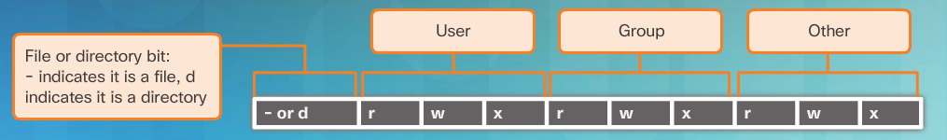
The Raspberry Pi Single Board Computer (SBC) Using the Linux Operating System (Cont.)
Process Managing Commands
In Linux, a process is any task or command being executed by the system.
PIDs are unique numbers assigned to processes for identification.
ps, top and kill are commands used to manage processes.
File Permissions
In Linux, most everything is treated as a file.
File Permissions provide a mechanism to define permissions to files.
Possible permissions rights are Read, Write, and Execute and can be defined for the user who owns the file, the group, and other system users.
The root user can override file permissions.
Notes:
3.2 – The Raspberry Pi Single Board Computer (SBC)
3.2.3 –Using the Linux Operating System (Cont.)

Slide 17
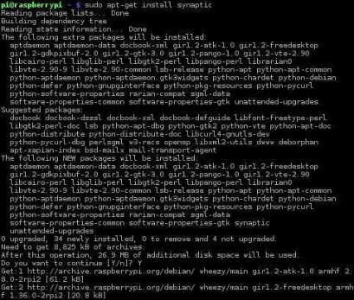
The Raspberry Pi Single Board Computer (SBC) Using the Linux Operating System (Cont.)
Package Managers
Maintaining computer programs and their library dependencies manually is not scalable
Package managers facilitate the installation, removal, and upgrade of computer programs.
Package managers usually include user tools and a remote package repository.
The repository hosts software packages and their dependencies.
dpkg and rpm are popular package managers for Debian Linux and Red Hat Linux, respectively.
Raspbian includes dpkg and apt by default.
Notes:
3.2 – The Raspberry Pi Single Board Computer (SBC)
3.2.3 –Using the Linux Operating System (Cont.)

Slide 18

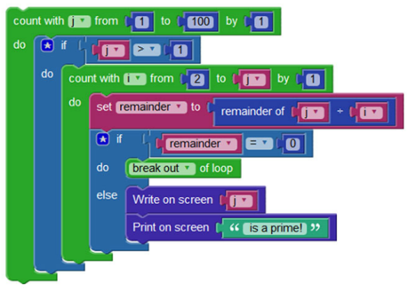
The Raspberry Pi Single Board Computer (SBC) 3.2.4 Blockly
Variables and Basic Statements
Blockly allows the creation of a program without entering any lines of code; it uses colored blocks.
Blocks can be connected together by dragging and attaching the appropriate blocks.
Creating a new variable in Blockly is a simple matter of dragging the variable block and filling in the value slot.
IF-THEN
Used to allow the code to make decisions.
FOR Loops
Used to repeat the execution of a block of code for a specific number of times.
WHILE Loops
Used to execute a block of code while a condition is true.
Notes:
3.2 – The Raspberry Pi Single Board Computer (SBC)
3.2.4 –Blockly

Slide 19

The Raspberry Pi Single Board Computer (SBC) 3.2.5 Python on the Raspberry Pi
Using Blocky to Learn Python
Blockly can be used to enhance Python understanding.
Beginners can create Blockly programs, convert them to Python and study the result.
The Python Interpreter
The Python interpreter understands and executes Python code.
Python code can be created in any text editor and Python interpreters are available for many operating systems.
Python developers can create and deploy Python programs in practically any operating system.
When called with no arguments, the Python interpreter displays the “>>>” prompt and waits for commands; this is called interactive mode.
Notes:
3.2 – The Raspberry Pi Single Board Computer (SBC)
3.2.5 –Python on the Raspberry Pi

Slide 20
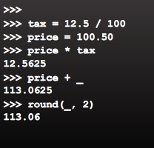
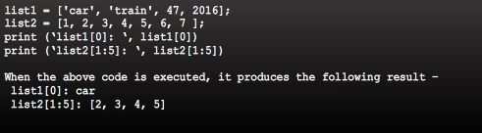
The Raspberry Pi Single Board Computer (SBC) Python on the Raspberry Pi (cont’d)
Variables and Basic Statements in Python
Variables are labeled memory areas used to store runtime program data.
To assign values to variables in Python, use the = (equal to) sign.
Python’s interactive mode implements the special variable “_”.
Useful Functions and Data Types in Python
Python supports many useful functions and data types such as range(), tuples, lists, sets, and dictionary
Notes:
3.2 – The Raspberry Pi Single Board Computer (SBC)
3.2.5 –Python on the Raspberry Pi

Slide 21
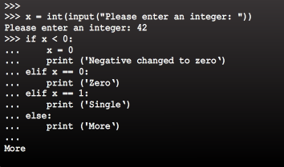
The Raspberry Pi Single Board Computer (SBC) Python on the Raspberry Pi (cont’d)
Importing Modules Into Your Code
Use the import <module> keyword to import pre-written code into your programs.
IF THEN In Python
Allows the execution a block of code based on the result of an expression.
FOR Loops in Python
Iterates through the items of any sequence
WHILE Loops in Python
Executes a block of code while the expression is true
Indentation is important in Python!
Notes:
3.2 – The Raspberry Pi Single Board Computer (SBC)
3.2.5 –Python on the Raspberry Pi

Slide 22
The Raspberry Pi Single Board Computer (SBC) Python on the Raspberry Pi (cont’d)
Cisco Support for Cybersecurity Professionals
DevNet
Cisco provides a beneficial community named DevNet.
DevNet is available to assist you in learning to code, use software and programs, and partner with others.
Webex Teams
Webex Teams is a cloud service that provides persistent chat, room-based collaboration, WebRTC video conferencing, and more.
Developers can create code that can be used to integrate specific solutions with Webex Teams via the Webex Teams REST API.
Webex Teams REST API can include automated Webex Teams messages based on real-world events that occur in a popular application/program
Notes:
3.2 – The Raspberry Pi Single Board Computer (SBC)
3.2.5 –Python on the Raspberry Pi

Slide 23
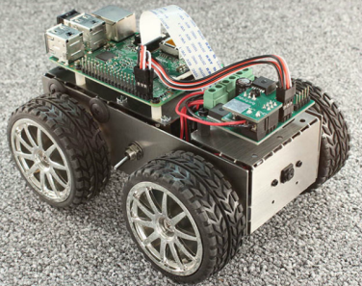
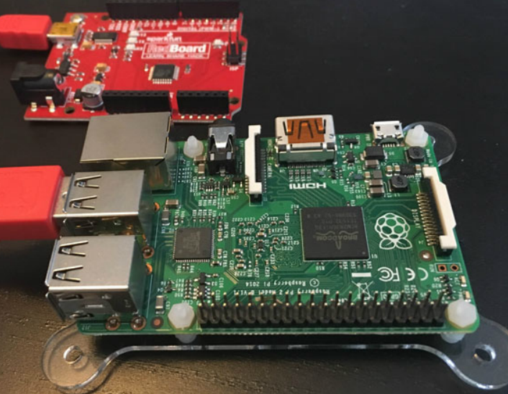
The Raspberry Pi Single Board Computer (SBC) 3.2.6 Uses of the Raspberry Pi
Artificial Raspberry Pi Pancreas
Dana Lewis and her husband used a Raspberry Pi to build an artificial pancreas.
It was possible due to the Pi’s small size and low power requirements.
4Borg Pi Robot
PiBorg is an affordable robot kit built around a Raspberry Pi.
It is both fun and educational.
Controlling the Arduino Through the Pi
While the Pi is powerful, it may not be the best option for all projects.
The Pi doesn’t include analog GPIO pins.
The Pi is not real-time.
The Pi’s power requirements and size may be too large, depending on the application.
To adjust to these limitations, an Arduino may be used.
Notes:
3.2 – The Raspberry Pi Single Board Computer (SBC)
3.2.6 –Uses of the Raspberry Pi

Slide 24
3.3 Building Models of IoT Systems in Packet Tracer
Notes:
Cisco Networking Academy Program
Connecting Things
Chapter 3: Software is Everywhere

Slide 25
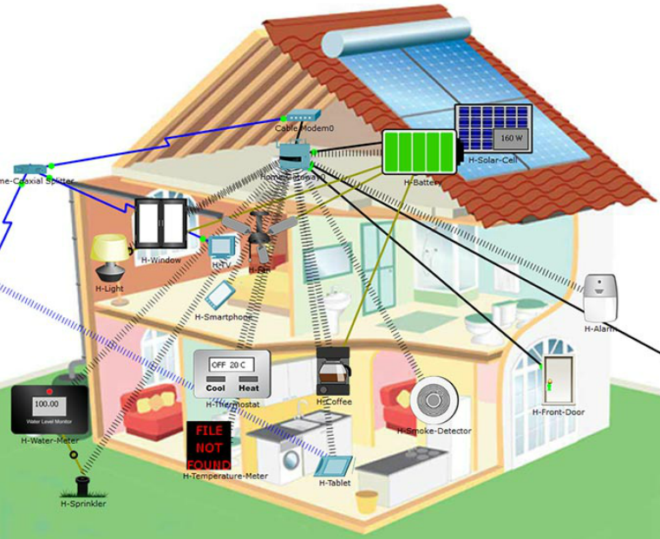
Building Models of IoT Systems in Packet Tracer 3.3.1 A Model of an IoT System
Introducing The Home Automation Model
PT7.0 supports a wide range of IoT devices, such as sensors, actuators, microcontrollers, single board computers, and fog computing devices.
PT7.0 allows the design, configuration, programming, and troubleshooting of sophisticated models of IoT systems.
The Components of the Systems
In the Smart Home example, all devices connect to the Home Gateway, which acts as a concentrator for all devices.
Sensors monitor the environment while code makes sure values stay within a pre-defined threshold.
The code also takes appropriated actions if the monitored values fall out of the pre-defined threshold.
The cable modem and splitter pair is what provides Internet connectivity to the Home Gateway and consequently, to the entire home.
Notes:
3.3 – Building Models of IoT Systems in Packet Tracer
3.3.1 –A Model of an IoT System

Slide 26
Building Models of IoT Systems in Packet Tracer A Model of an IoT System (Cont.)
The SBC Code in Packet Tracer
PT 7.0 also introduces a single board computer (SBC) and a microcontroller unit (MCU).
PT SBC simulates an SBC such as a Raspberry Pi.
PT SBC provides 2 USB ports and 10 digital I/O ports which can be used to connect IoT sensors and devices.
PT SBC has a Python interpreter built in, accessible via PT SBC’s Programming tab.
PT 7.0 also supports an MCU emulator.
PT MCU can be programmed similarly to real-word MCUs.
PT MCU has one USB port, six digital I/O ports, and four analog I/O ports.
PT MCU can also be programmed with Python.
Notes:
3.3 – Building Models of IoT Systems in Packet Tracer
3.3.1 –A Model of an IoT System (Cont.)

Slide 27
3.4 Chapter Summary
Notes:
Cisco Networking Academy Program
Connecting Things
Chapter 3: Software is Everywhere

Slide 28
Chapter Summary Summary
Programs (also called code) are used in IoT to provide logic and intelligence to the devices. A programmer can create code to allow an IoT device to perform tasks such as monitoring, communicating to others, data processing and more.
The Raspberry Pi, single board computer, is designed to be small and consume very little power.
The Cisco PL-App allows access to the Raspberry Pi directly from the network without the need for a monitor, keyboard or mouse to be directly connected to the Pi.
The Raspberry Pi runs Raspbian, a modified version of the open source and wide-spread Linux operating system.
The Raspberry Pi supports many different programming languages including Blockly, a visual programming language, designed to help beginners learn how to program. This course focuses on Python, a popular, simple and powerful programming language.
With added support to Python, Cisco Packet Tracer is a great tool to model, prototype and test entire IoT systems.
Notes:
3.4.1.1 - Summary

Slide 29


Slide 30


